Slide 1

APPLICATION WEBSITE FOR IRCTC

Slide 2
AIM:
TO NAVIGATE E-TICKET BOOKING APPLICATION FOR IRCTC

Slide 3
REQUIREMENTS
INTERNET CONNECTION
USERNAME(PHONE.NO OR E-MAIL ID)
PASSWORD
APP(IRCTC)

Slide 4
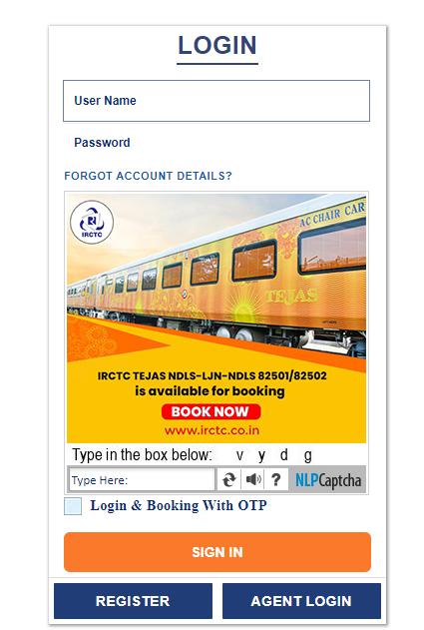
IRCTC LOGIN PAGE

Slide 5
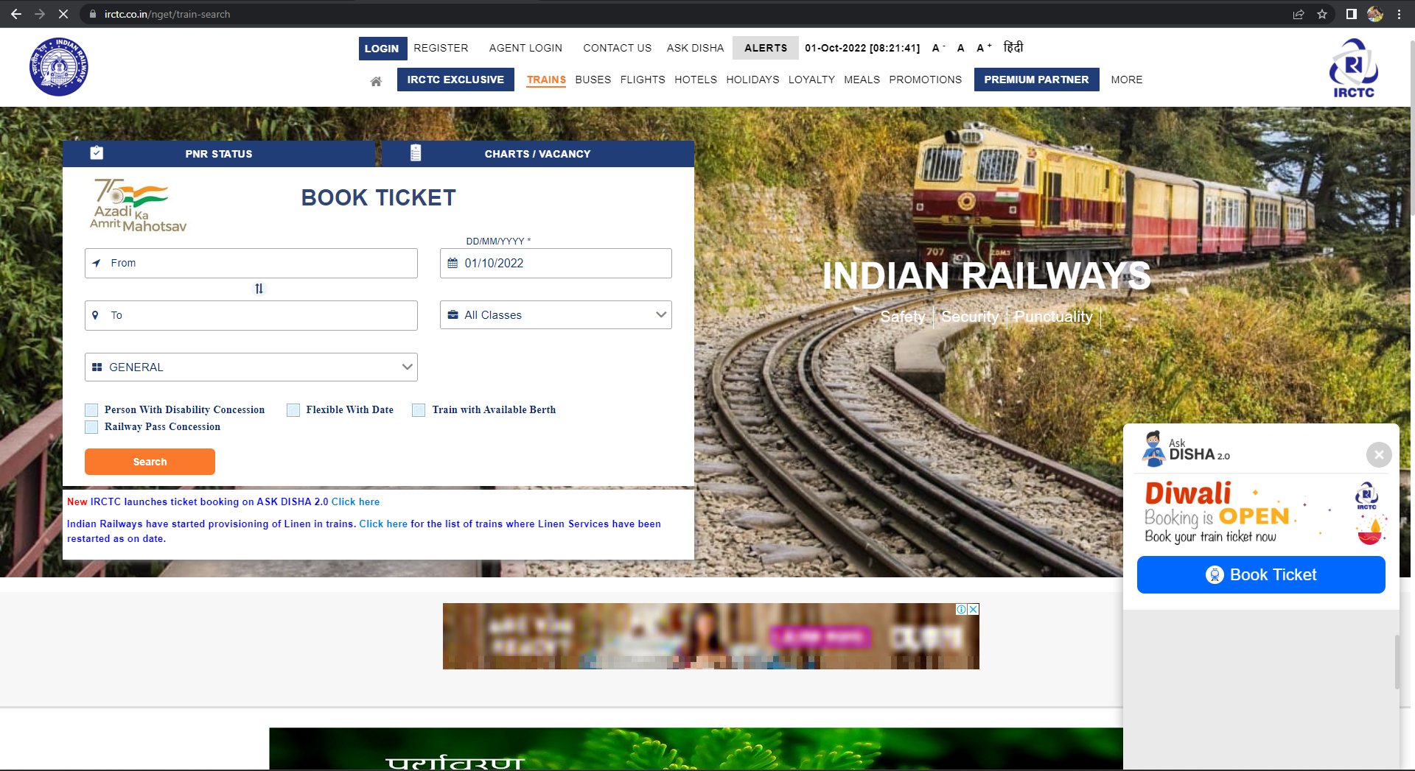
IRCTC SEACHING PAGE

Slide 6
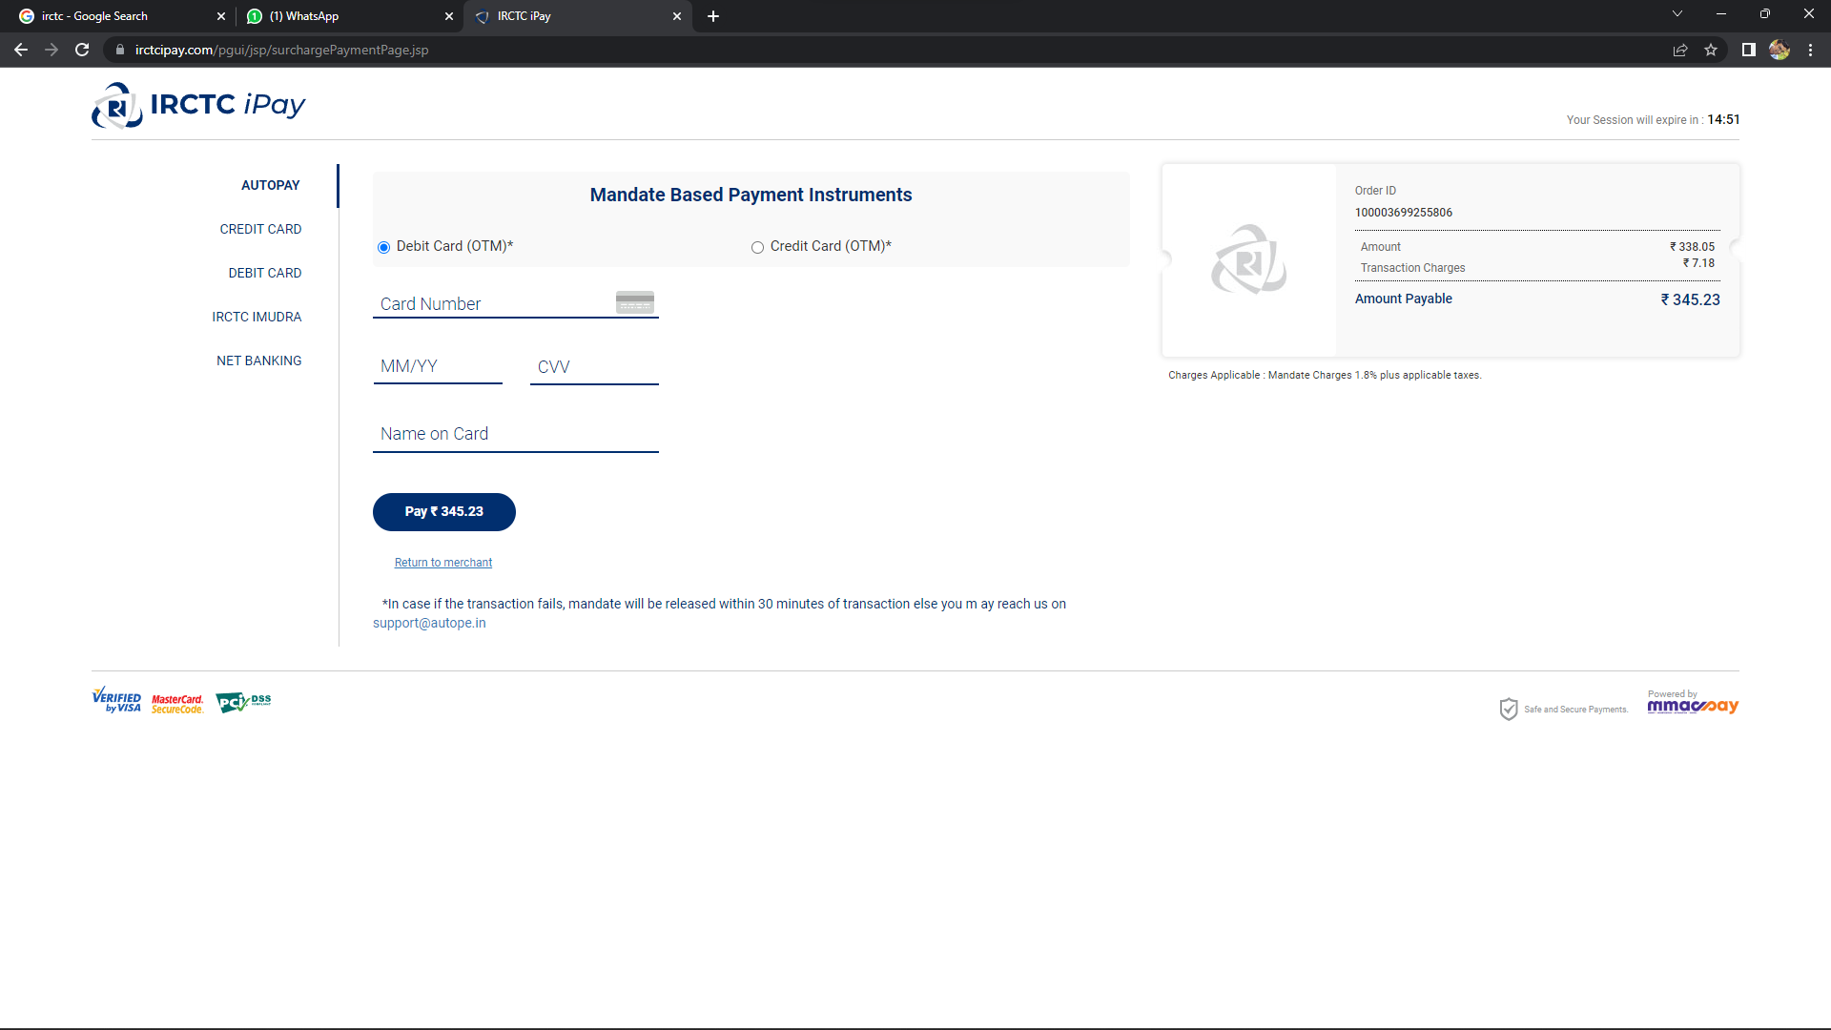
PAYMENT PAGE

Slide 7
POSITIVE SCENARIO'S
1.Signup-New User Registration. 2.Account Activation through Email 3.Account Activation through Mobile 4.Forgot Password for Password reset 5.Plan My Trip Feature 6.Quick Book Feature 7.Link to Book Mumbai Season Ticket 8.My Transactions 9. Booked History 10. Print E-Ticekt

Slide 8
Negative test scenario
1. Past date in DATE field should not be accepted 2. On manually adding DATE 3. without giving any information, click on the submit button 4. Special characters other than / should not be accepted 5. In FROM field, Special characters should not be accepted 6. In FROM field, Number 0-9 should not be accepted 7. In FROM field, City name should not start with space. 8. In FROM field, City name should not start with special character. 9. In FROM field, City name should not start with number. 10. If any of the field is missing its value, then SUBMIT Button should be disabled.

Slide 9
Test case
TEST CASE | PASS/FAIL
Verify on filling train details like From station, To station, Departure date, list of available trains are displayed. | PASS
Verify that users can search for trains by name, from-to station for checking their status and timings. | PASS
Verify that search results have train details, timings and availability. | PASS
Verify that the user should see real time train status of availability of seats | PASS
Verify that the pricing of different types of seats in a train is displayed to the users. | PASS
Verify user is able to book one ticket per document | FAIL
Verify when user tries to cancel the ticket on the day of travelling then he should not get full amount as refund. | FAIL
Verify when user should not be able to cancel the ticket after the train has left the station. | FAIL
Verify user is getting extra benefit if he has purchased a ticket of AC compartment. | FAIL
Verify user can get document with out getting SMS | FAIL

Slide 10
CONCLUSION
I HAVE NAVIGATE THE AMAZON WEB APPLICATION AND FIND OUT THE POSITIVE / PASS AND NEGATIVE / FAIL TEST CASES. THIS IS TO IMPROVE THE APPLICATION PERFORMANCE IN BETTER MANNER.

Slide 11


